Slide 1
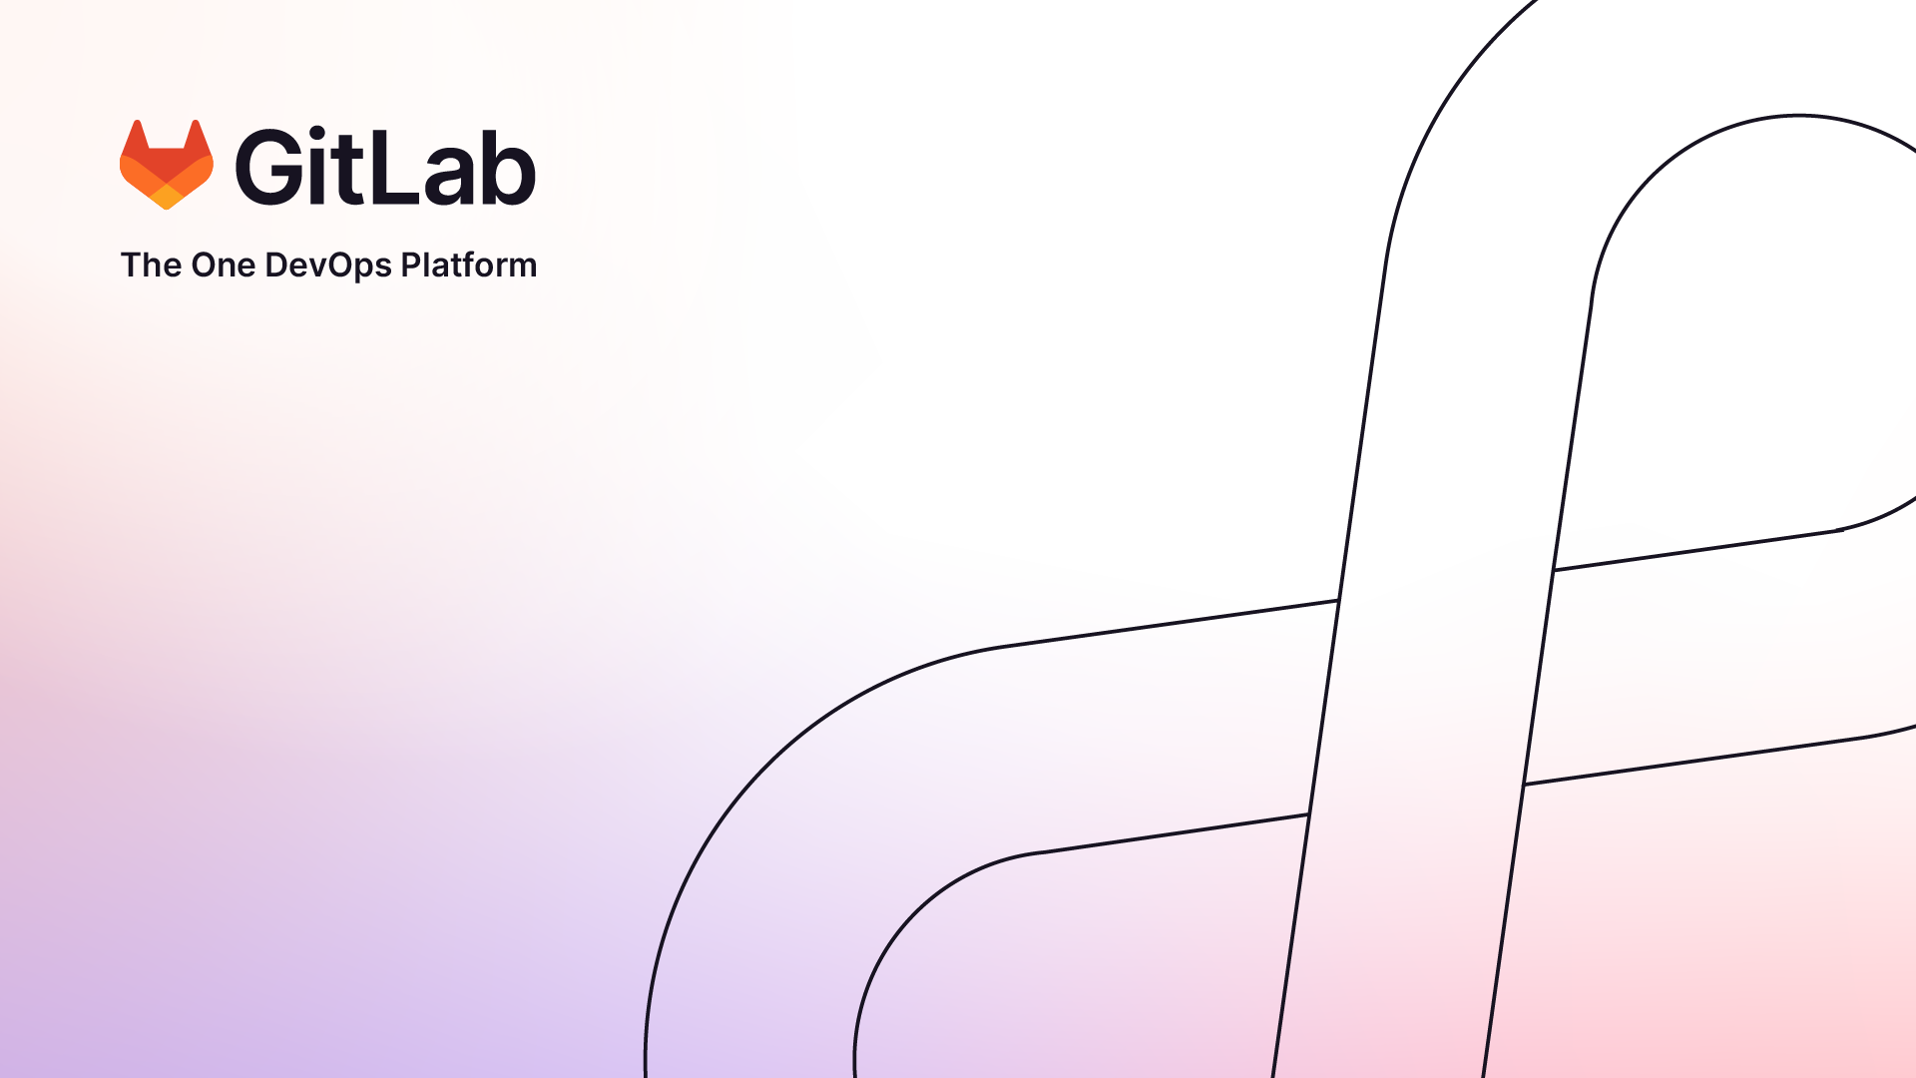

Slide 2


Let's dive in!
In this review ,We will explore GitLab's remarkable features and delve into its functioning. GitLab has gained widespread adoption due to its ability to simplify the software development lifecycle and empower teams to work seamlessly and collaboratively. So, let's plunge into the world of GitLab and uncover its capabilities!

Slide 3

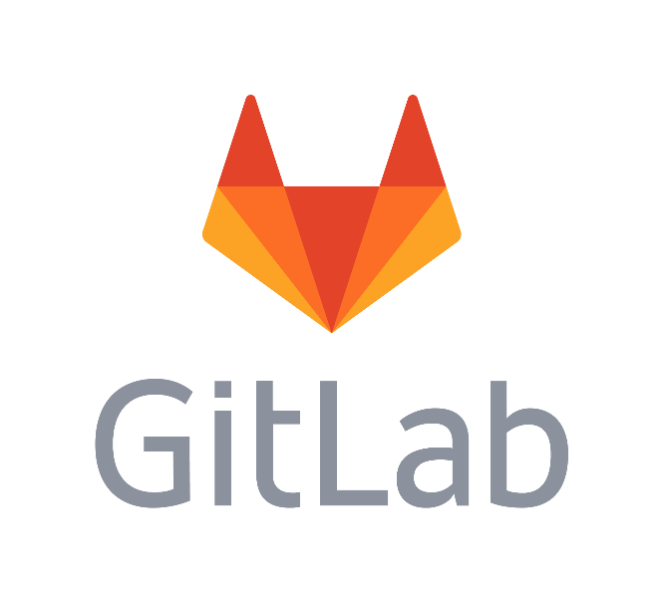
Outline
GitLab and its key features
GitLab’s UI and Anatomy of a Project
GitLab’s CI / CD Pipeline
Integration and Extensibility
GitLab and Security
GitLab and Cloud
Gitlab and AI
Conclusion

Slide 4
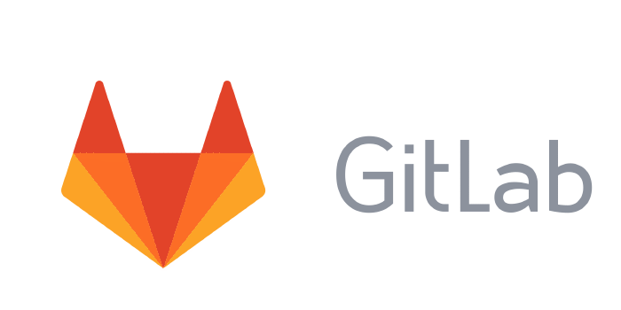
What Is GitLab ?
What are its Key Features ?

Slide 5
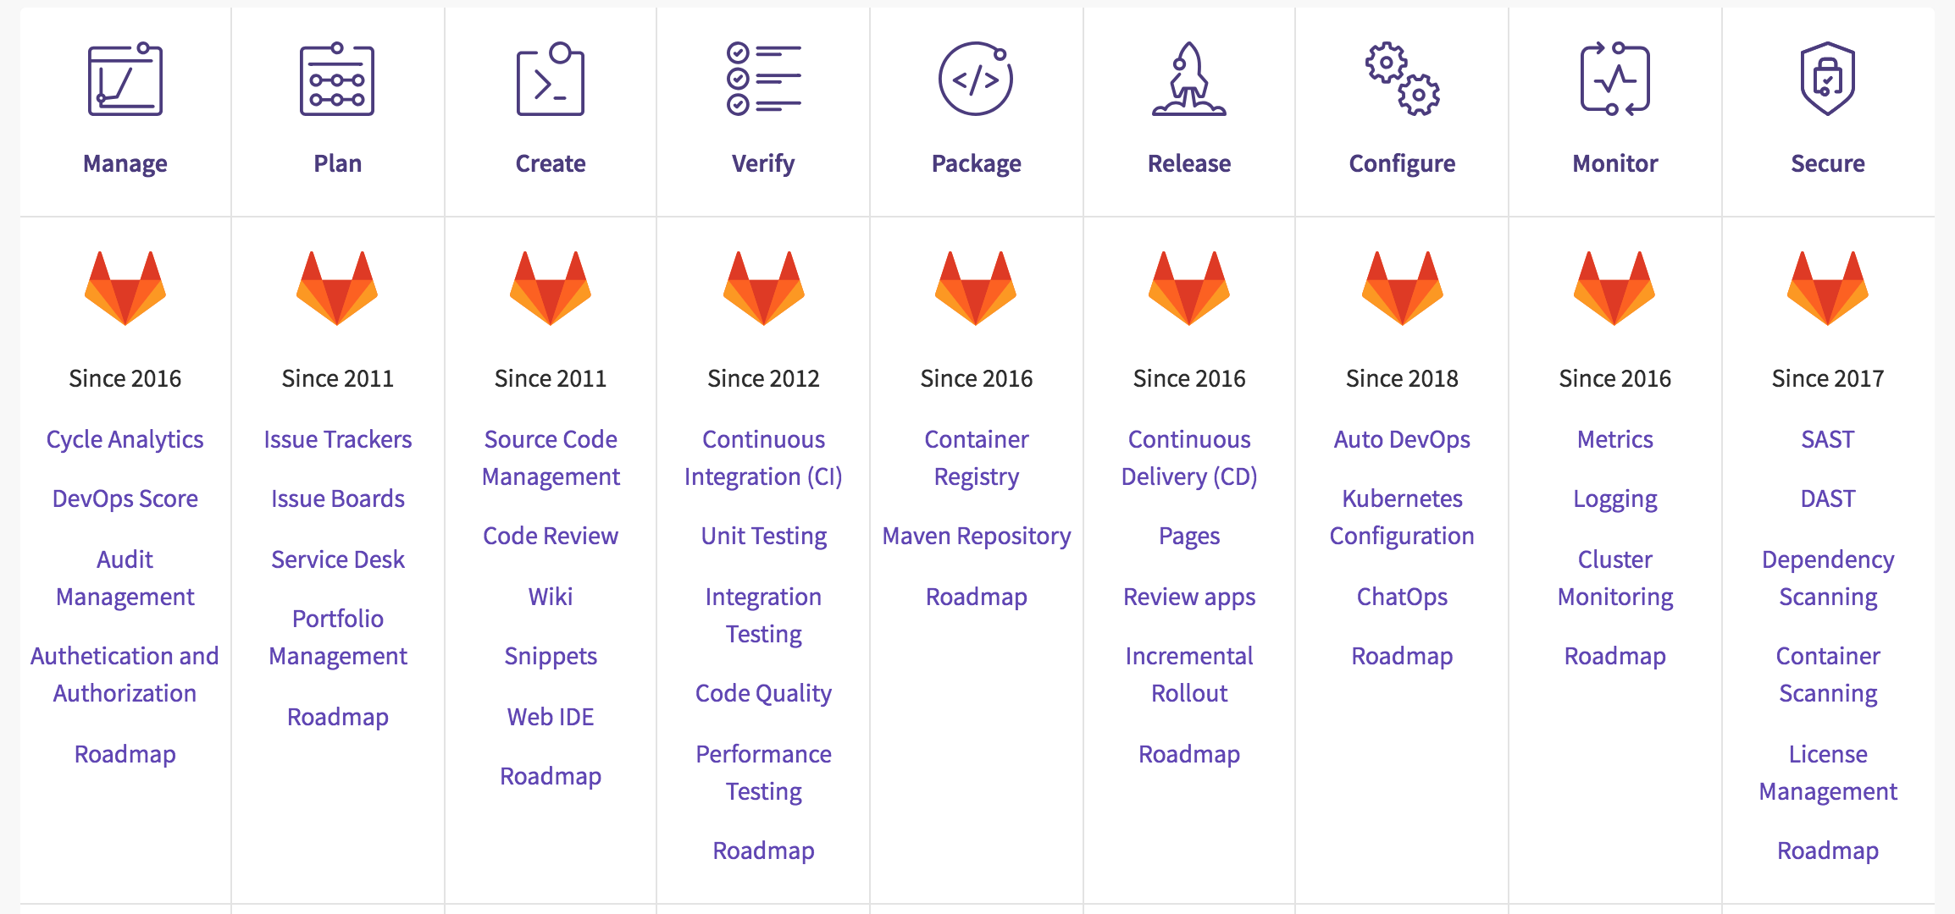
What Is GitLab ?
an online platform relying on Git and designed for organizations. It is a complete DevOps platform that enables professionals to perform all the tasks in a project.

Slide 6

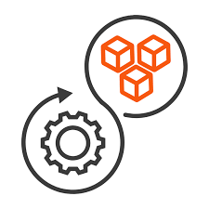

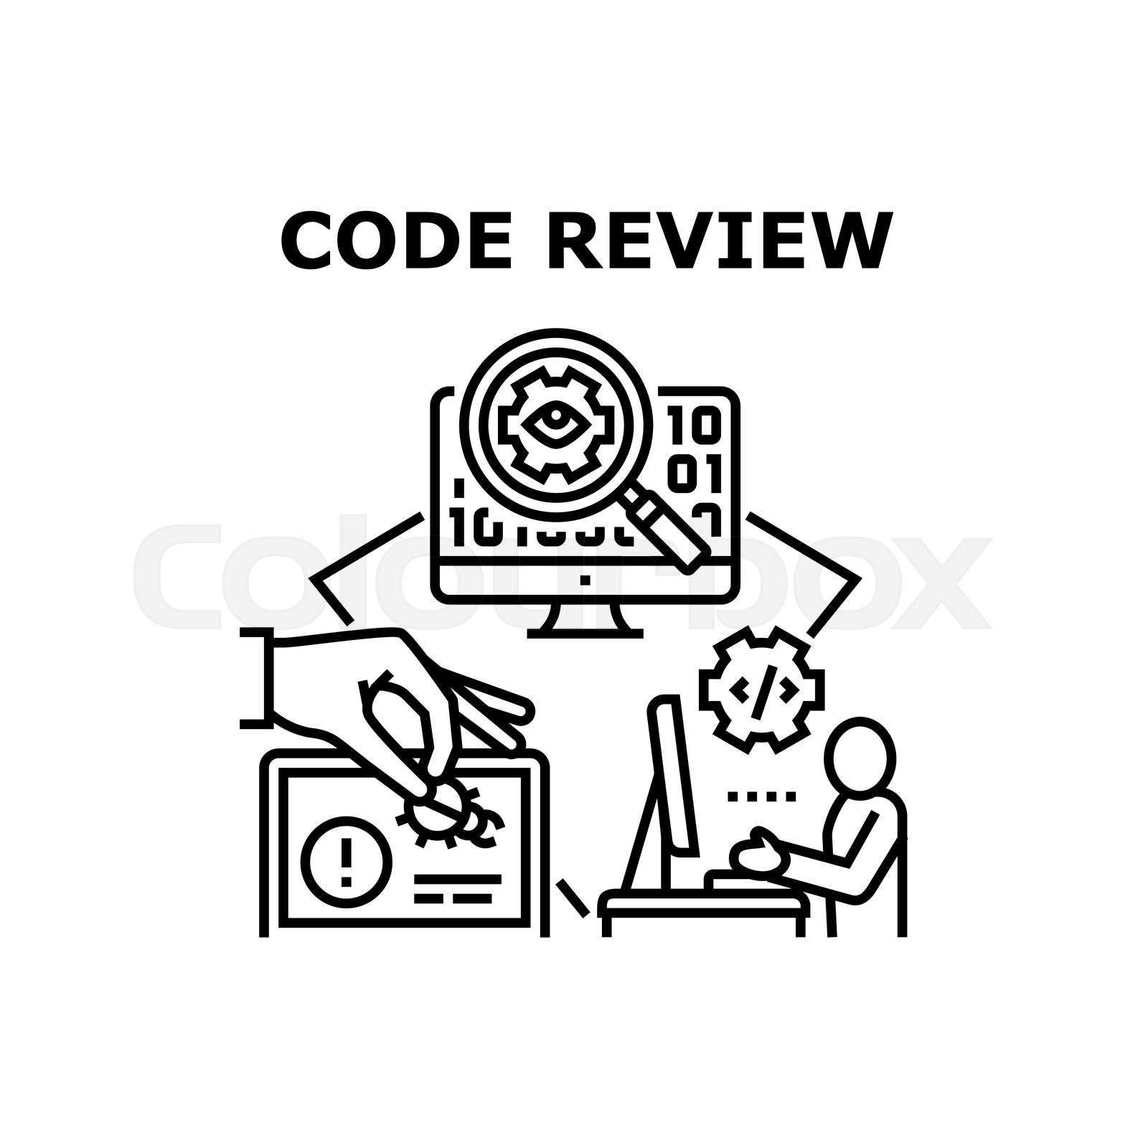

Key Features
Some important features to consider :
User-friendly UI and tools
Version Control
Code Review
CI/CD
Issue Tracking

Slide 7
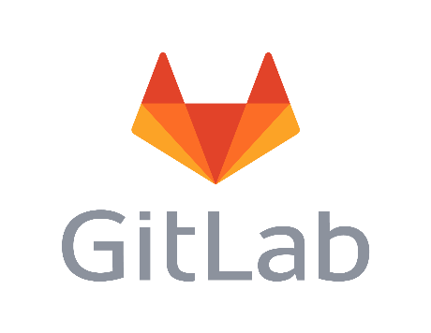

Version Control and Code Management:
GitLab
Git
Version control system

Slide 8

Git Concept
Open Source
Distributed
Records changes, maintains history of files
Great branching model that adapts to most
workflows
Fast & reliable
Two different persons can work on the same code
without hindering each other’s progress .

Slide 9



Why a Version Control ?
Disaster recovery
When an issue occurs in an environment , teams need to be able to reproduce that environment within a specific timeframe to restore the service.
Auditability
To demonstrate the integrity of the delivery process, teams should be able to provide the history of each deployment, including the versions of the elements involved.
Higher quality
When teams can automatically prepare these environments from version control, they can receive faster feedback on the impact of their changes, leading to improved software quality.

Slide 10


Why a Version Control ?
Capacity management
When teams want to scale up their environments' capacity, it is essential to create replicas of existing servers. This feature enables horizontal scaling of modern, cloud-based distributed systems.
Failure response
When teams identify a critical failure or vulnerability in certain components of their system, they need to release a new version of their software as quickly as possible. Storing all artifacts in version control allows teams to quickly and reliably roll back to a previously validated working state.

Slide 11
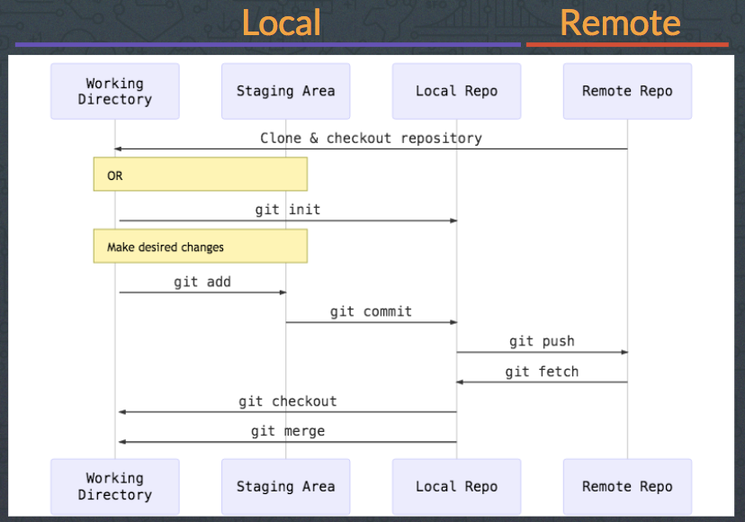
Basic Git Workflow

Slide 12
What We will see in the platform

Slide 13
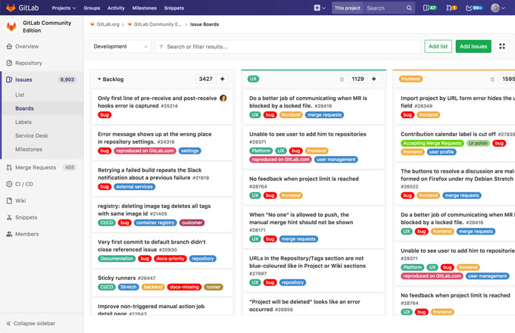
Plan:
Get your best ideas into development

Slide 14
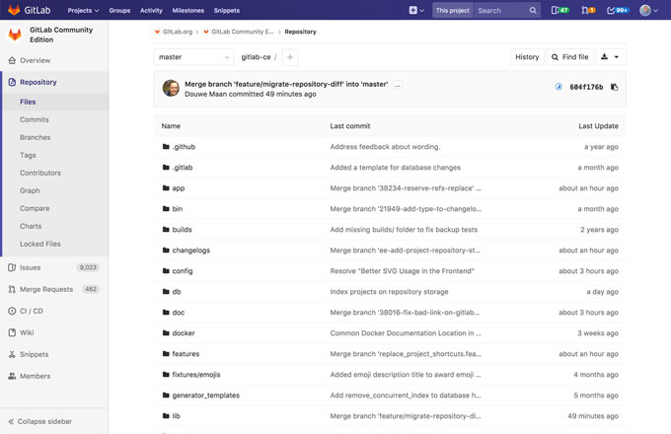
Create:
Securely write and manage code and project data

Slide 15
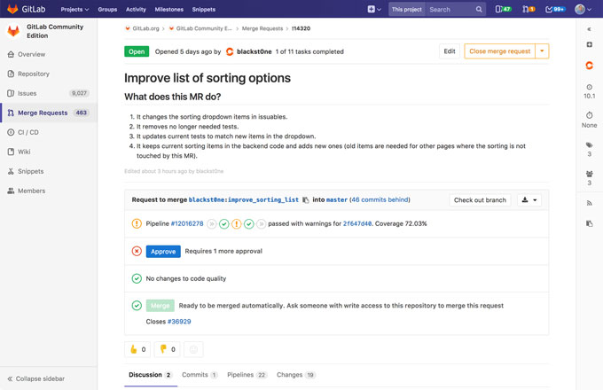
Verify:
Ship better software , faster

Slide 16
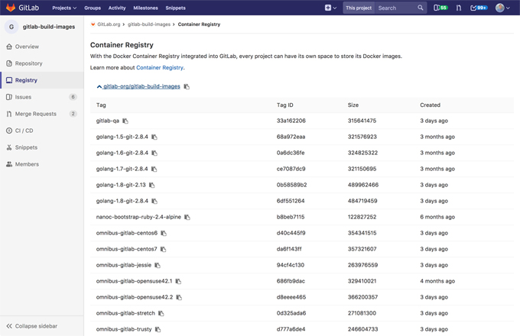
Package :
Manage custom container images with ease

Slide 17
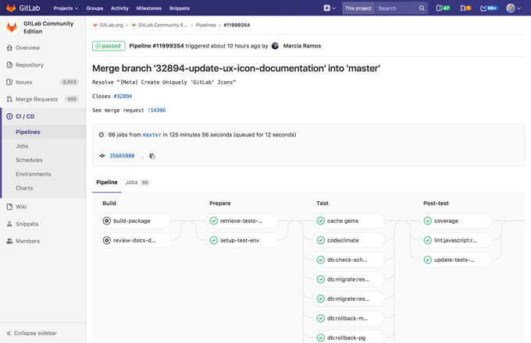
Release :
Minimize complexity with built-in Continuous Delivery

Slide 18
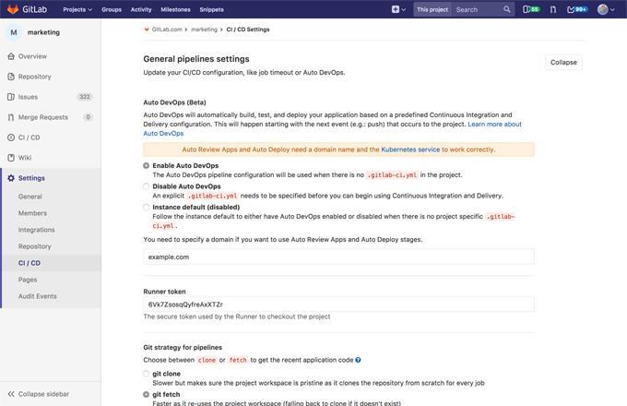
Configure :
Automate configuration management

Slide 19
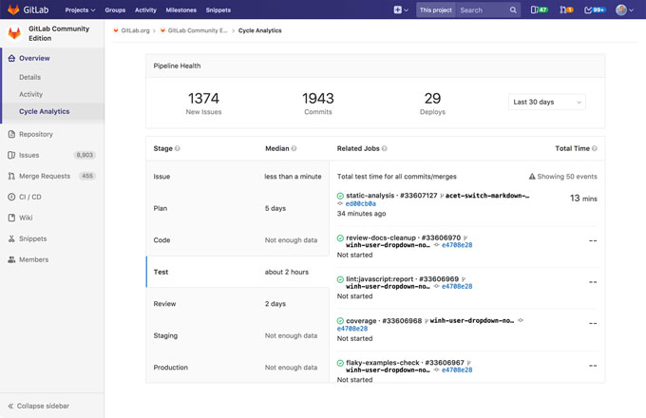
Monitor :
Analyze velocity & monitor application performance

Slide 20
Anatomy Of a Project

Slide 21
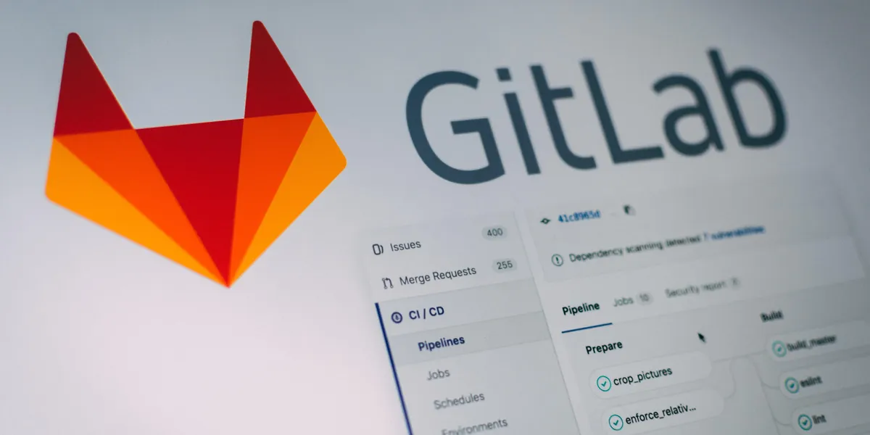
Anatomy of a Project
Merge Requests
Repository
Issues
CI / CD

Slide 22
Anatomy of a Project
Wiki
Snippets
Settings

Slide 23
Code Management From GitLab
Git
Version control system

Slide 24
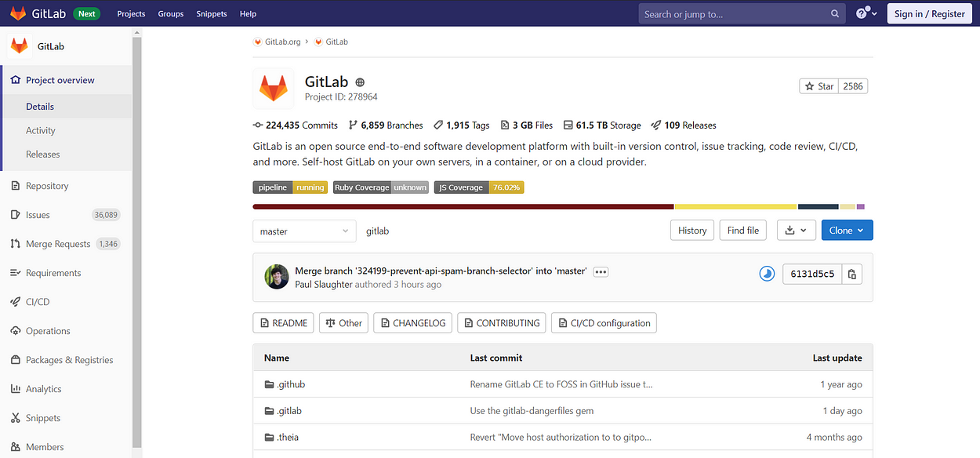
GitLab Project Overview
Creating a GitLab account is free, so if you use it in a corporate context the project’s administrator will add you in the company’s relevant project(s).
You can potentially work on GitLab with the same account for professional projects as well as for personal projects (depending on the email address you use to create your account).

Slide 25
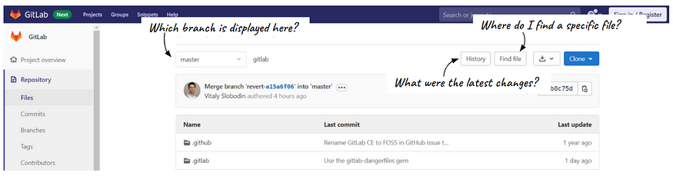
Settling in GitLab?
Repository :
To each project on GitLab corresponds a repository. This is where you will find all the files included in your project but also the history of changes and the status of the existing branches:
1 .Files: the top navigation bar allows you to find the exact file and version you are looking for.

Slide 26
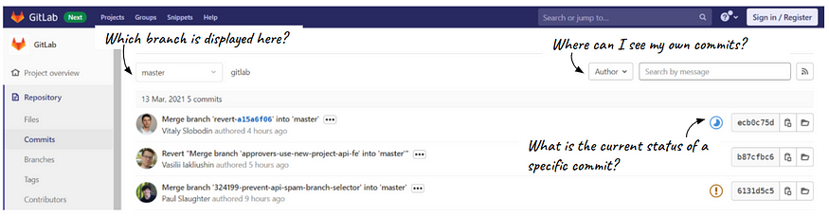
Settling in GitLab?
Repository :
To each project on GitLab corresponds a repository. This is where you will find all the files included in your project but also the history of changes and the status of the existing branches:
2.Commits: this part displays all the recent changes that were committed and merged into the selected branch

Slide 27
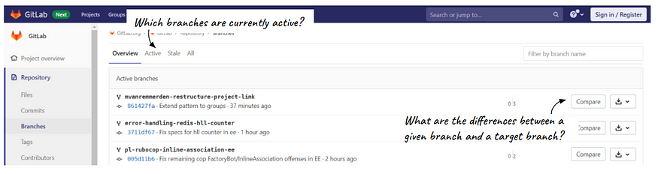
Settling in GitLab?
Repository :
To each project on GitLab corresponds a repository. This is where you will find all the files included in your project but also the history of changes and the status of the existing branches:
3. Branches: here you see all the project’s branches and their current status (“master” being the main branch, you can also browse the branches that you or your colleagues created)

Slide 28
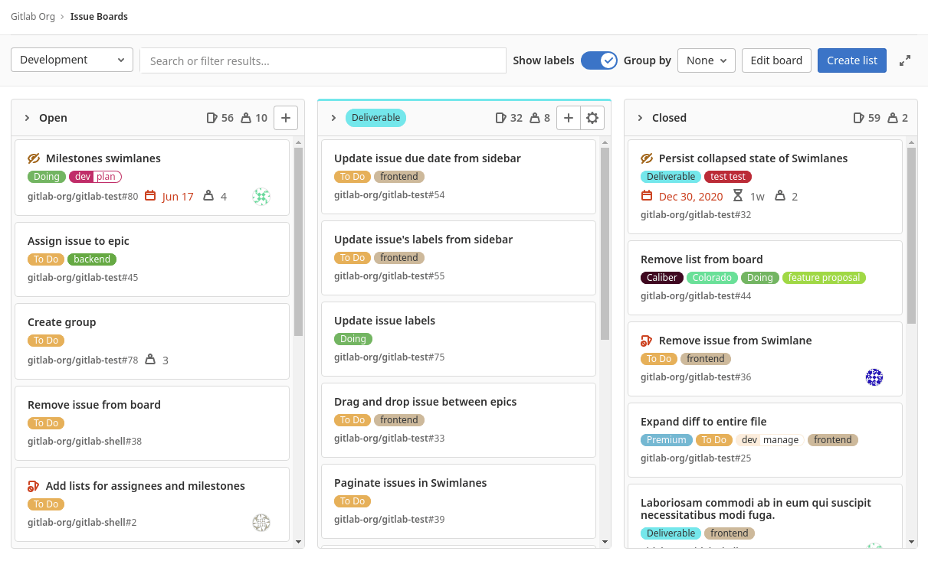
Issues
are a core building block in GitLab that enable collaboration, discussions, planning and tracking of work.
Issues are defined in the scope of a Project. NOT a Group.
Groups have Epics.
Issue Board
Labels
Milestones

Slide 29
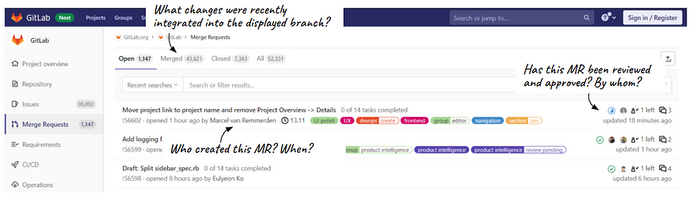
Contributing: How to bring your personal touch to the project?
Merge Requests
For making changes to the code located on the “master” branch.
1.Overview of merge requests: it allows you to quickly grasp the changes that your teammates have been working on and want to integrate into the “master” branch

Slide 30
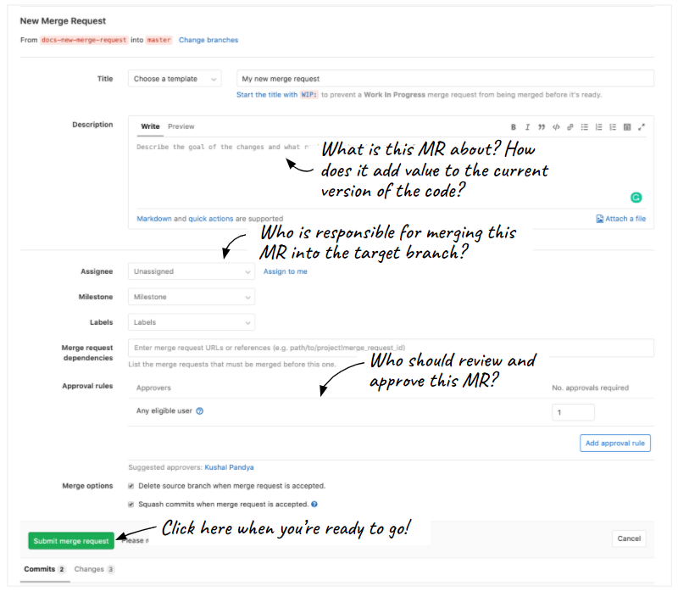
Contributing: How to bring your personal touch to the project?
Merge Requests
For making changes to the code located on the “master” branch.
2.Create a new merge request: when you are ready to ask your colleagues to review, approve and then merge your modifications into the “master” branch, you can click on “Create a merge request” and follow the instructions

Slide 31
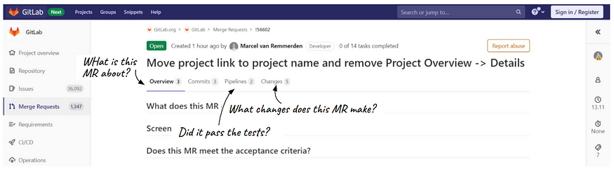
Contributing: How to bring your personal touch to the project?
Merge Requests
For making changes to the code located on the “master” branch.
Details of merge requests: when you click on a merge request (should it be yours or someone else’s) you can view its details in four tabs — overview, commits, pipelines, and changes

Slide 32
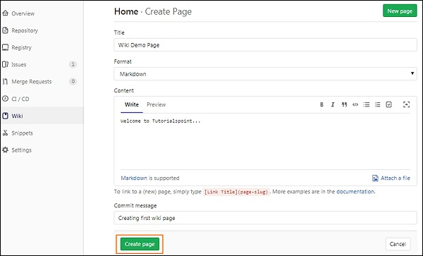
GitLab Wiki :
a system for maintaining documentation for a project in the GitLab. It is like a Wikipedia which can be editable and given permissions to manage the wiki pages. A Guest can view a wiki page and Developer can create and edit a wiki page.

Slide 33
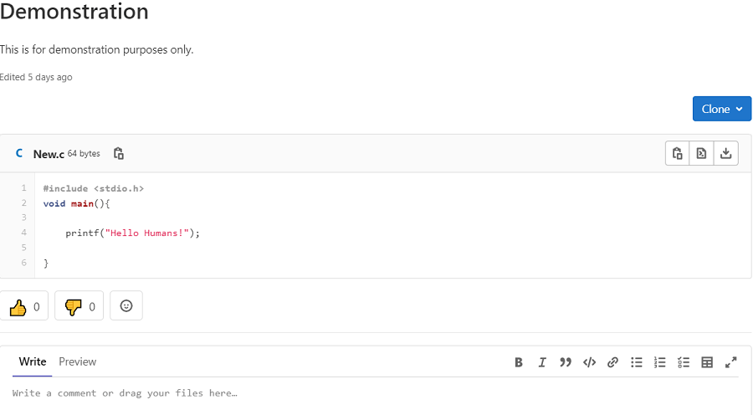
GitLab Snippets :
With GitLab snippets, you can store and share bits of code and text with other users. You can comment on , clone , and use version control in snippets. They can contain multiple files. They also support syntax highlighting, embedding, downloading.

Slide 34
GitLab’s CI / CD Pipeline

Slide 35
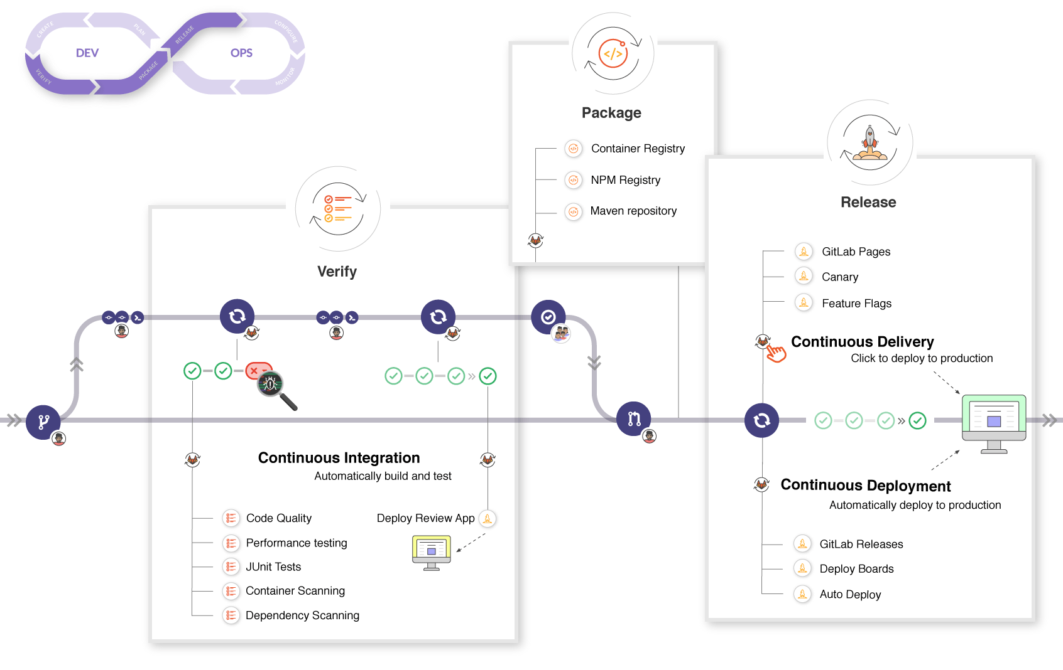
GitLab CI / CD :
GitLab has built-in CI/CD capabilities that automate the process of building, testing, and deploying applications. Users can define custom pipelines to define the stages and actions for their specific project requirements.

Slide 36
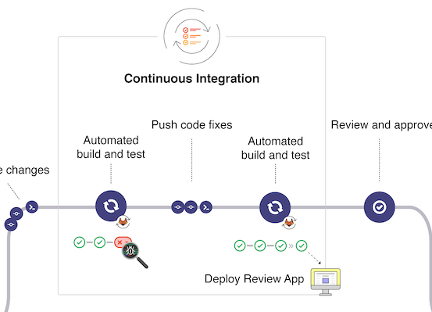
GitLab CI / CD :
Continuous Integration :
Each change submitted to an application, even to development branches, is built and tested automatically and continuously.
These tests ensure the changes pass all tests, guidelines, and code compliance standards you established for your application.

Slide 37
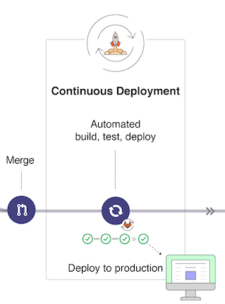
GitLab CI / CD :
Continuous Delivery:
is a step beyond Continuous Integration
checks the code automatically, but it requires human intervention to manually and strategically trigger the deployment of the changes.

Slide 38
GitLab CI / CD :
Continuous Deployment:
is another step beyond Continuous Integration, similar to Continuous Delivery.
The difference is that instead of deploying your application manually, you set it to be deployed automatically.
Human intervention is not required.

Slide 39
GitLab CI / CD Pipeline Configuration Reference:
GitLab CI/CD pipelines are configured using a YAML file called .gitlab-ci.yml within each project.
The .gitlab-ci.yml file defines the structure and order of the pipelines and determines:
What to execute using GitLab Runner.
What decisions to make when specific conditions are encountered. For example, when a process succeeds or fails.

Slide 40
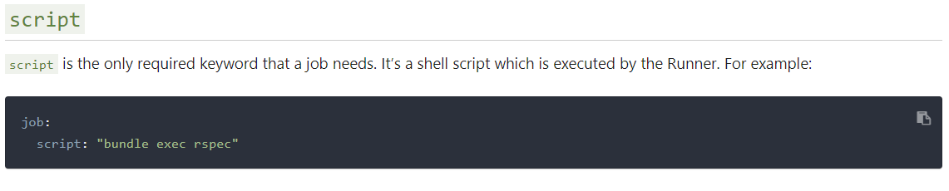
GitLab CI / CD Pipeline Configuration Reference:
Some common commands used in GitLab CI/CD pipelines:
script:
The script keyword is used to define the commands that will be executed within a job. It can be a single command or a series of commands.

Slide 41
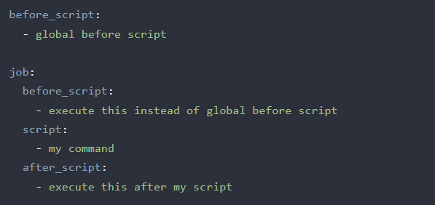
GitLab CI / CD Pipeline Configuration Reference:
Some common commands used in GitLab CI/CD pipelines:
before_script :
allows you to define commands that will be run before the main script commands. This is useful for setting up the environment or installing dependencies.
after_script:
The after_script keyword defines commands that will be run after the main script commands. These commands can be used for cleanup tasks or additional actions.

Slide 42
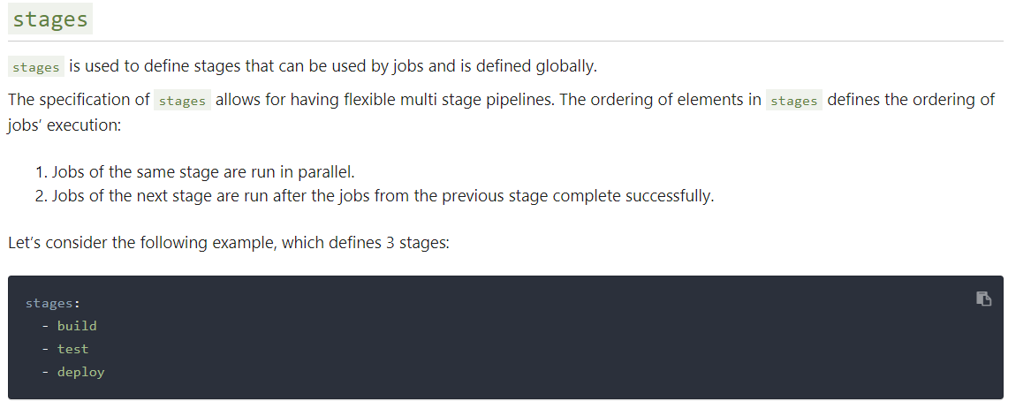
GitLab CI / CD Pipeline Configuration Reference:
Some common commands used in GitLab CI/CD pipelines:
stages:
The stages keyword allows you to define the different stages of your pipeline. Jobs within the same stage are executed in parallel, while stages are executed sequentially.

Slide 43
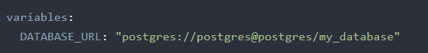
GitLab CI / CD Pipeline Configuration Reference:
Some common commands used in GitLab CI/CD pipelines:
variables:
The variables keyword is used to define environment variables that will be available during the pipeline execution.

Slide 44
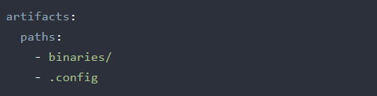
GitLab CI / CD Pipeline Configuration Reference:
Some common commands used in GitLab CI/CD pipelines:
artifacts:
The artifacts keyword specifies the files or directories that should be saved as job artifacts. Artifacts can be used to pass data between different stages or jobs within a pipeline.

Slide 45
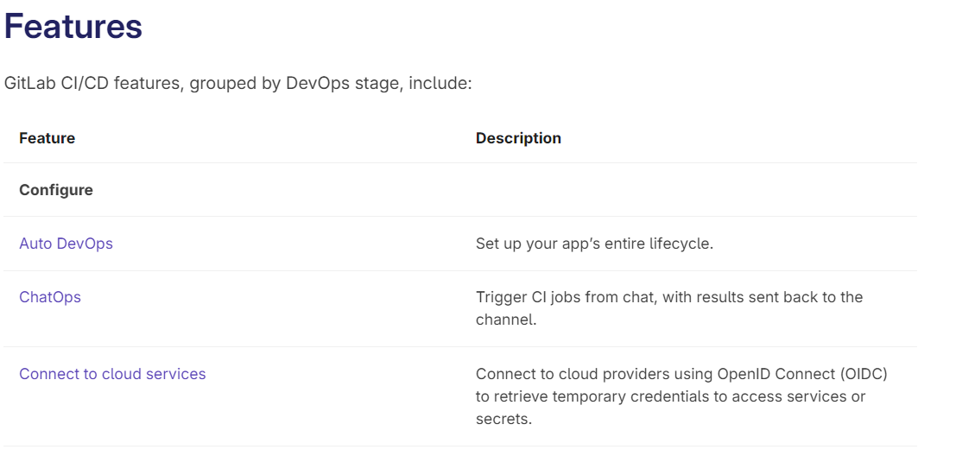
GitLab CI / CD :

Slide 46
Integration and Extensibility

Slide 47

Integration and Extensibility:
Powerful APIs :
designed to be RESTful, which means they follow standard HTTP conventions for interacting with resource
allows developers to perform a wide range of operations
support authentication and authorization using tokens and keys, ensuring secure communication between the client and the GitLab server.

Slide 48
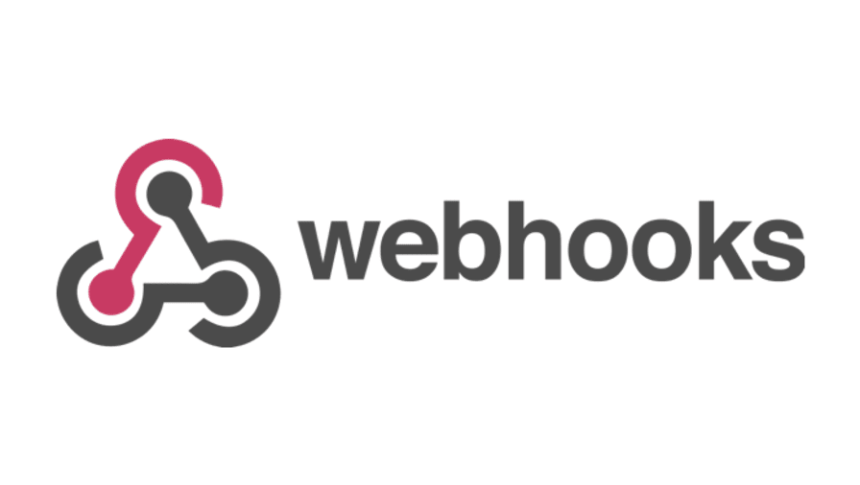
Integration and Extensibility:
Webhooks :
system allows external services to be notified about events that occur within GitLab
an HTTP callback that GitLab sends to a specified URL when specific actions or events take place, such as a push to a repository, a new issue creation, or a merge request update

Slide 49

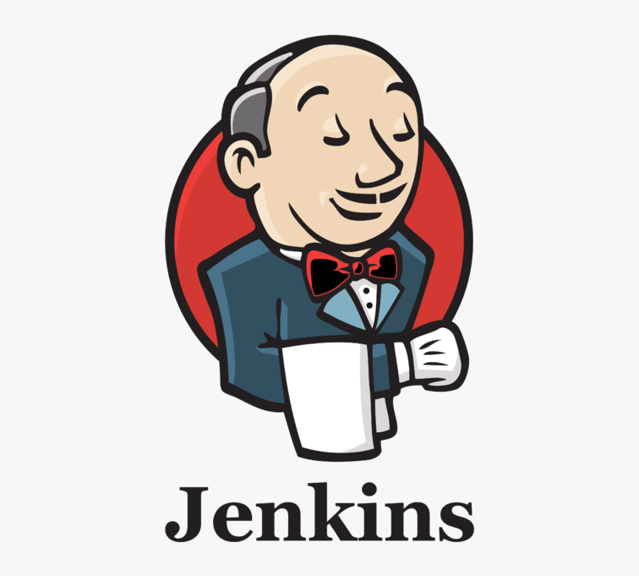


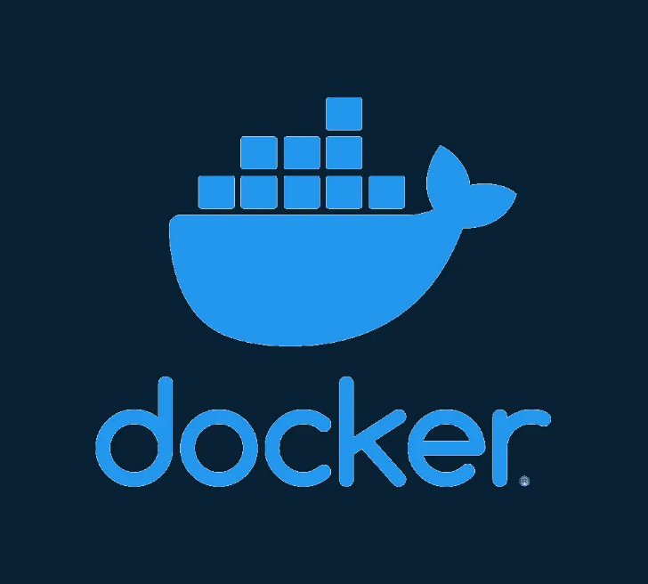


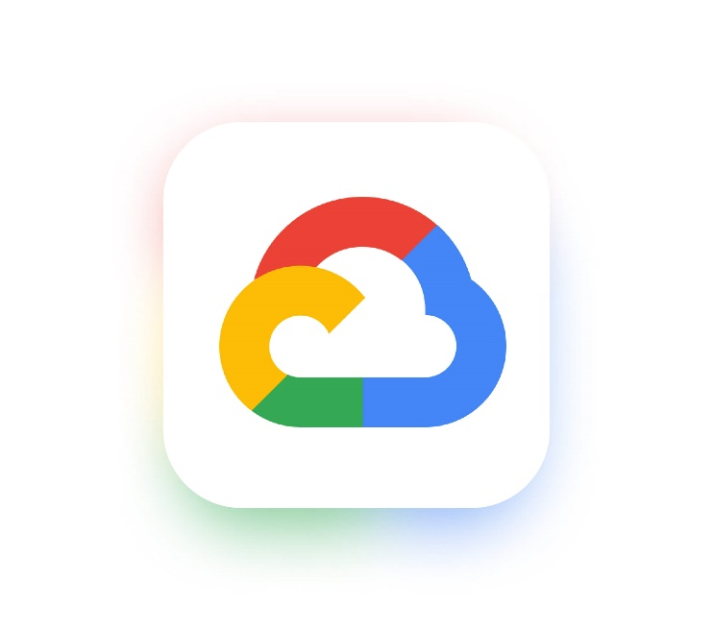
Integration and Extensibility:
GitLab also integrates well with third-party tools that developers may be using. For example :
AWS
Jenkins
JetBrains
Cisco
docker
Slack
Microsoft Azure
Google Cloud

Slide 50
GitLab Security

Slide 51
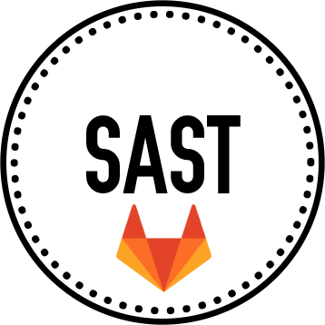
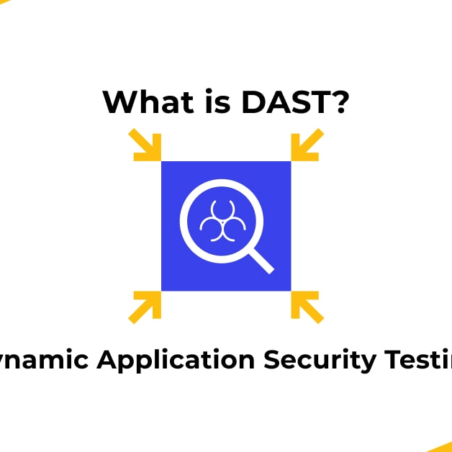

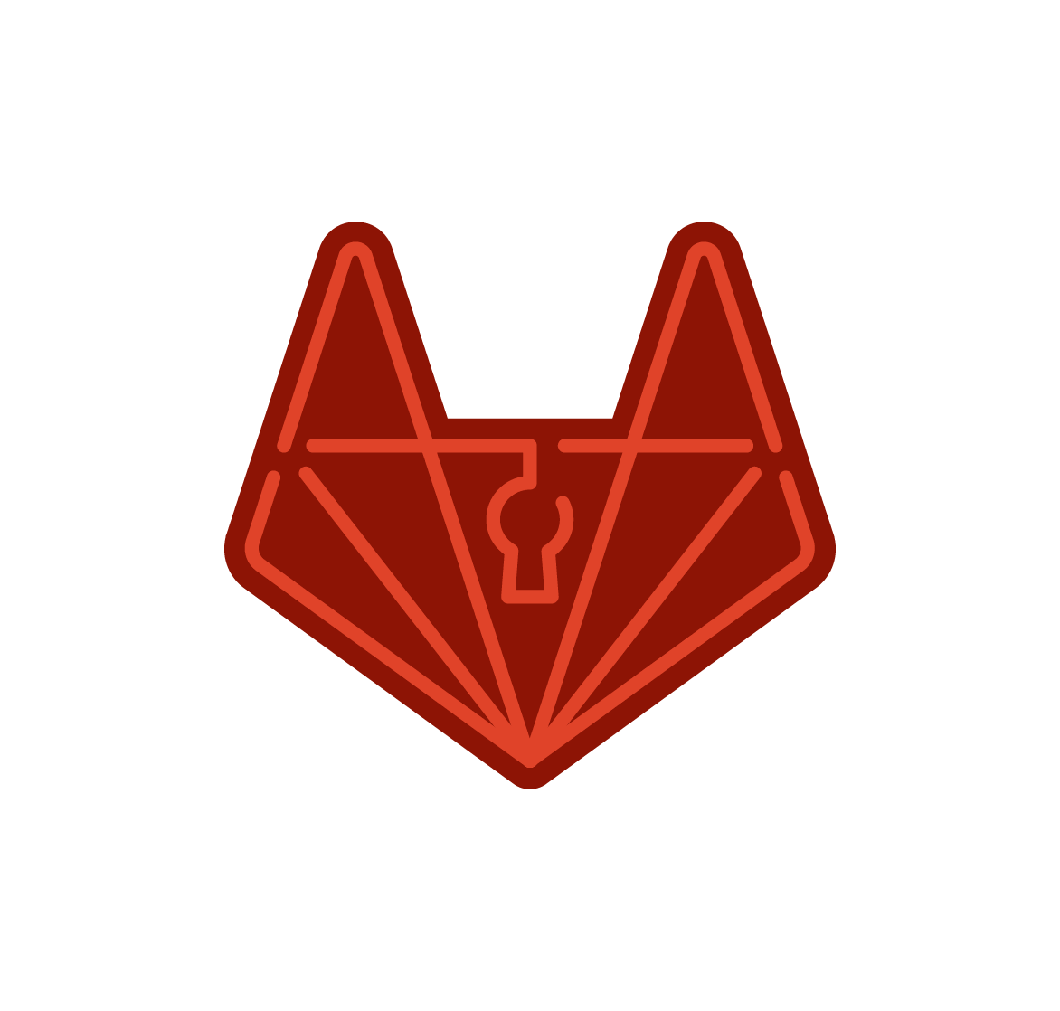
GitLab Security
SAST
DAST
Commit Stage
Test and Deploy Stages
GitLab provides Security capabilities, integrated into your development lifecycle.
Each of the GitLab application security tools is relevant to specific stages of the feature development workflow.
Secret Detection
Container Scanning
Commit Stage
Build Stage

Slide 52
GitLab Security
SAST :
SAST capabilities are available on all GitLab tiers. It’s designed for anyone that wants to check their source code for known vulnerabilities within GitLab CI/CD.
You can use SAST to find out if your code has any dangerous attributes or code that can lead to unintended executions.

Slide 53
GitLab Security
Secret Detection :
Secret detection is available on all GitLab tiers.
It’s common for developers to accidentally commit “secrets” to a remote Git repository.
These secrets can include sensitive information, passwords, API tokens, keys, and anything else that could be dangerous if it ends up in the wrong hands.
This feature is designed to prevent any secrets from being committed to a Git repository.

Slide 54
GitLab Security
Container Scanning:
Your application’s Docker image may itself be based on Docker images that contain known vulnerabilities.
By including an extra Container Scanning job in your pipeline that scans for those vulnerabilities and displays them in a merge request, you can use GitLab to audit your Docker-based apps.

Slide 55
GitLab Security
DAST :
If you deploy your web application into a new environment, your application may become exposed to new types of attacks.
Dynamic Application Security Testing (DAST) examines applications for vulnerabilities like these in deployed environments.

Slide 56
GitLab and Cloud

Slide 57
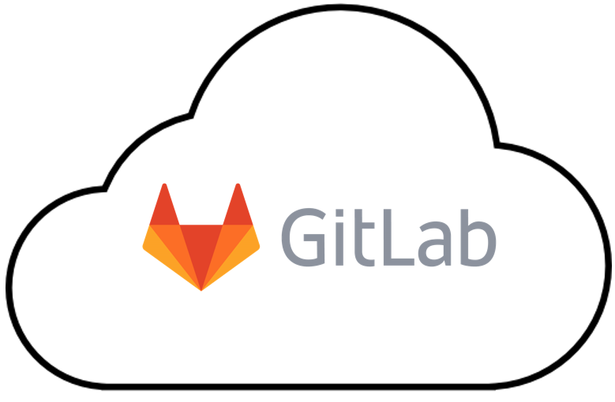
GitLab and Cloud
GitLab SaaS (Software as a Service):
GitLab.com is a SaaS offering.
Sign up and use GitLab without setting up infrastructure.
GitLab.com manages infrastructure, updates, and maintenance.
Focus on projects and collaboration without infrastructure concerns.
.com

Slide 58
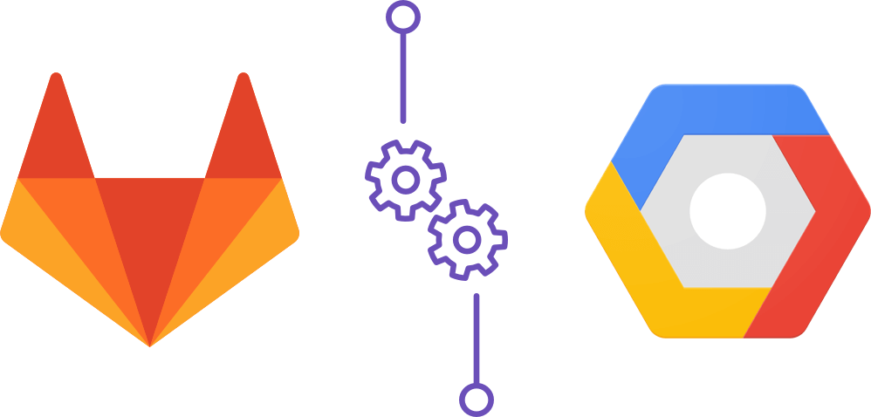
Self-Hosted Deployment on Cloud Providers:
GitLab can be deployed on AWS, GCP, and Azure.
Cloud deployment provides scalability, flexibility, and convenience.
You have full control over your GitLab instance, including customization, configuration, and scalability.

Slide 59
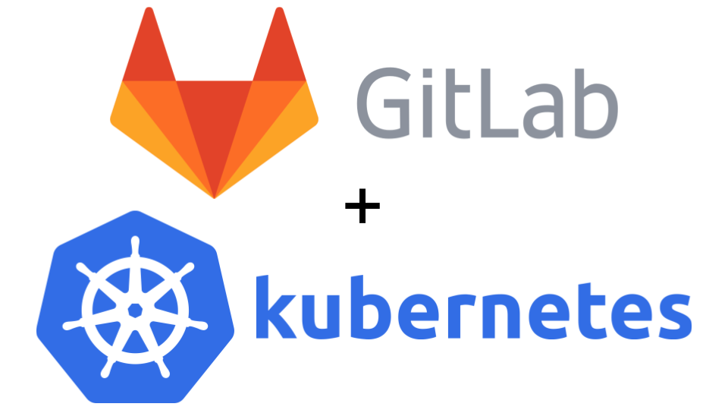
Kubernetes Integration:
GitLab integrates with Kubernetes.
Kubernetes (also known as k8s ) is an open-source container orchestration platform that automates many of the manual processes involved in deploying, managing, and scaling containerized applications.
Use in Cloud Native to develop scalable applications that are built to run in the cloud.
Deploy GitLab and use Kubernetes for CI/CD and managing containers.
Scale resources dynamically with Kubernetes.
Efficient utilization of cloud resources.

Slide 60
GitLab and AI

Slide 61

GitLab's journey to integrate AI
AI-assisted code suggestions
Writing SQL is a lot easier
Code suggestions and explanation
- Reducing errors and helping programmers write code faster
- Helping reproduce the much higher production code quality.
With the recent advancements in AI and natural language processing, it's now possible for AI models to generate SQL code from simple English language queries
.
viewing code suggestions as you type.
Allowing to get up to speed quickly by explaining source code.

Slide 62
GitLab's journey to integrate AI
GitLab Chat
Explain This Vulnerability
Value Stream Forecasting
- Helping quickly identify useful information in large volumes of text, such as documentation.
- Helping developers remediate vulnerabilities more efficiently and uplevel their skills, enabling them to write more secure code.
Predicting productivity metrics
identifying anomalies across your software development lifecycle.

Slide 63
GitLab's journey to integrate AI
Summarize Issue Comments
Suggested Reviewers
AI / Merge Requests
Quickly gets everyone up to speed on lengthy conversations to ensure you are all on the same page.
Helps you receive faster and higher-quality reviews by automatically finding the right people to review a merge request.
Summarize Proposed Merge Request Changes
Summarize Merge Request Review
Generate Tests in Merge Requests

Slide 64
What Makes GitLab Stand Out ?
Comprehensive CI/CD pipelines
Robust security features
allows developers to quickly and easily deploy applications with minimal effort.
such as role-based access control, code scanning, anomaly detection, and more.
Automation capabilities
Scalable architecture
developers can quickly automate processes and tasks, such as code reviews and testing.
allows it to be used for large-scale applications with no performance degradation.
Easy integration
Extensive documentation
popular tools and services, such as Kubernetes, making it easy to manage multiple projects from one single platform.
makes it easy for users to get up and running quickly.

Slide 65
Conclusion :
GitLab is a powerful DevOps platform for streamlined software development, collaboration, and deployment.
It offers efficient version control with Git for effective code tracking and management.
GitLab provides a collaborative environment that promotes seamless teamwork and communication among developers.
Integrated CI/CD pipelines automate building, testing, and deployment, reducing manual effort and accelerating time to market.

Slide 66
Conclusion :
By combining GitLab's robust DevOps platform with AI capabilities, developers can benefit from enhanced code quality, streamlined processes, automated workflows, and improved collaboration.
GitLab is suitable for organizations of all sizes, with options for self-hosted or GitLab.com deployment.
GitLab emphasizes security and compliance with features like code analysis, vulnerability scanning, and compliance management.

